Slide 1
Technical Support (420-1N6-AB) System Unit Components
Fall 2023

Slide 2
System Unit – Main Inner Components

Slide 3
Instructor prep
Take apart a computer and bring it in class
Have additional components ready to circulate
PSU
Motherboard with a different form factor
CPU PGA
CPU LDA
RAM
HHD
SSD
Heat sink

Slide 4
Outline
System Unit Main Components:
Case
Power Supply Unit
Connectors
Motherboard
Expansion slots
Buses
CPU
Cooling Devices
Chipset
RAM
GPU
Storage Device

Slide 5

Question for you?
Have you ever looked inside your own computer?
(or someone else’s)
For what reason?
What did you see inside?

Slide 6
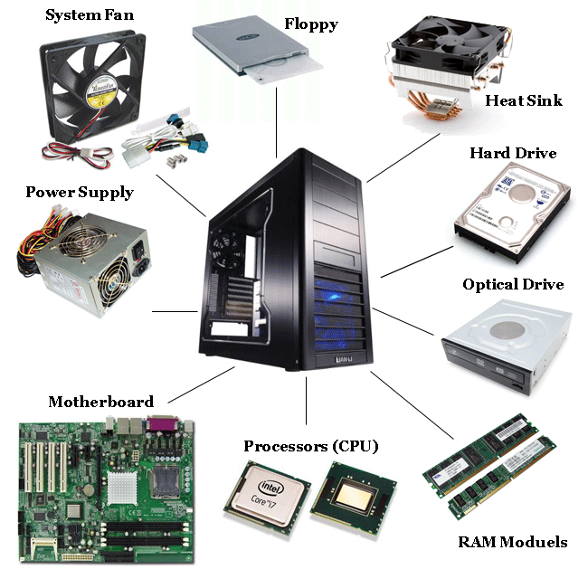
Inside A Computer – The system unit
Case
Power Supply
Motherboard
Connectors
Cooling Devices
Processor (CPU)
Chipset
Buses
Memory (RAM)
Storage Devices

Slide 7
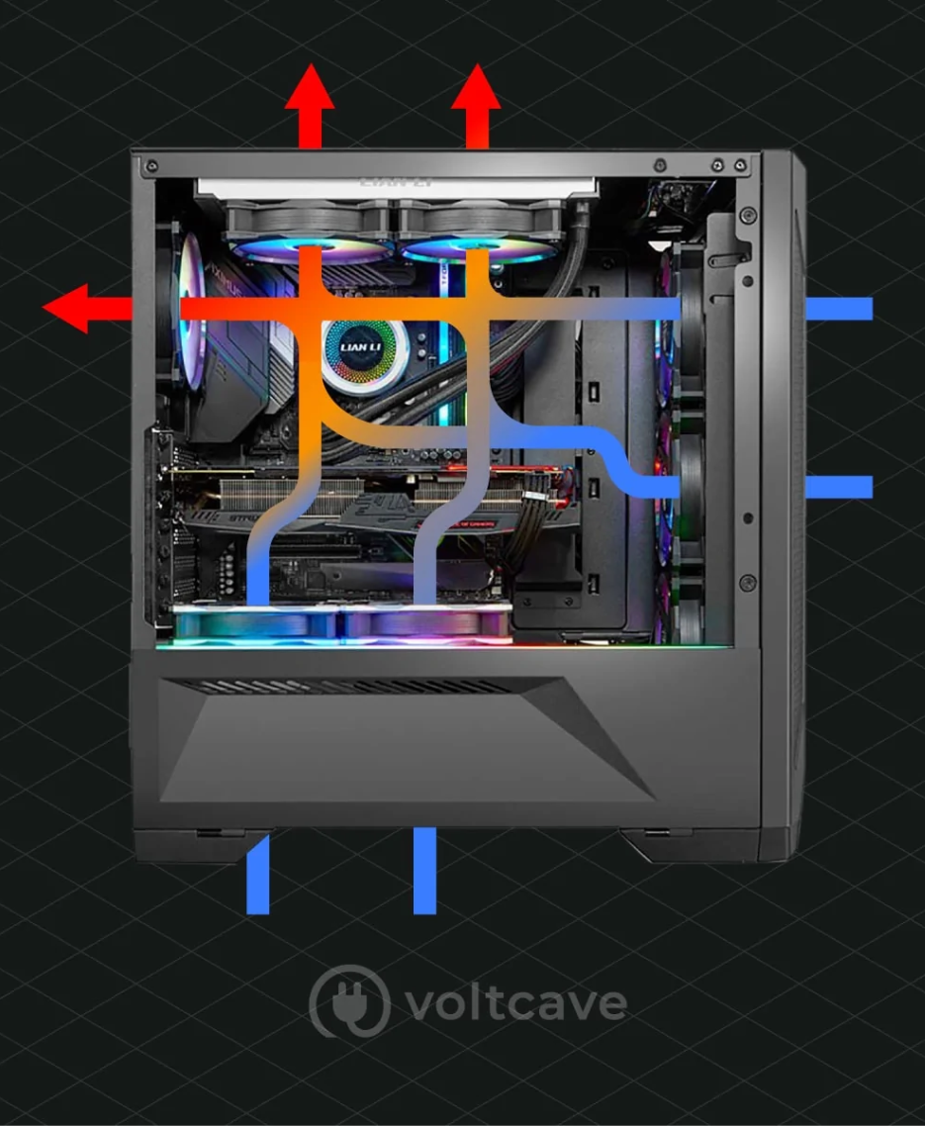
Case
Provides protection and cooling for the internal components.
Also prevents damage from static electricity (components grounded via attachment to case).
Usually made of plastic, steel or aluminum.
Fans move air through the case:
to replace warm air with cold air to keep components at stable temperatures
to prevent build-up of dust
There exist many guides/studies for optimal airflow. E.g. https://voltcave.com/pc-airflow-guide/

Slide 8
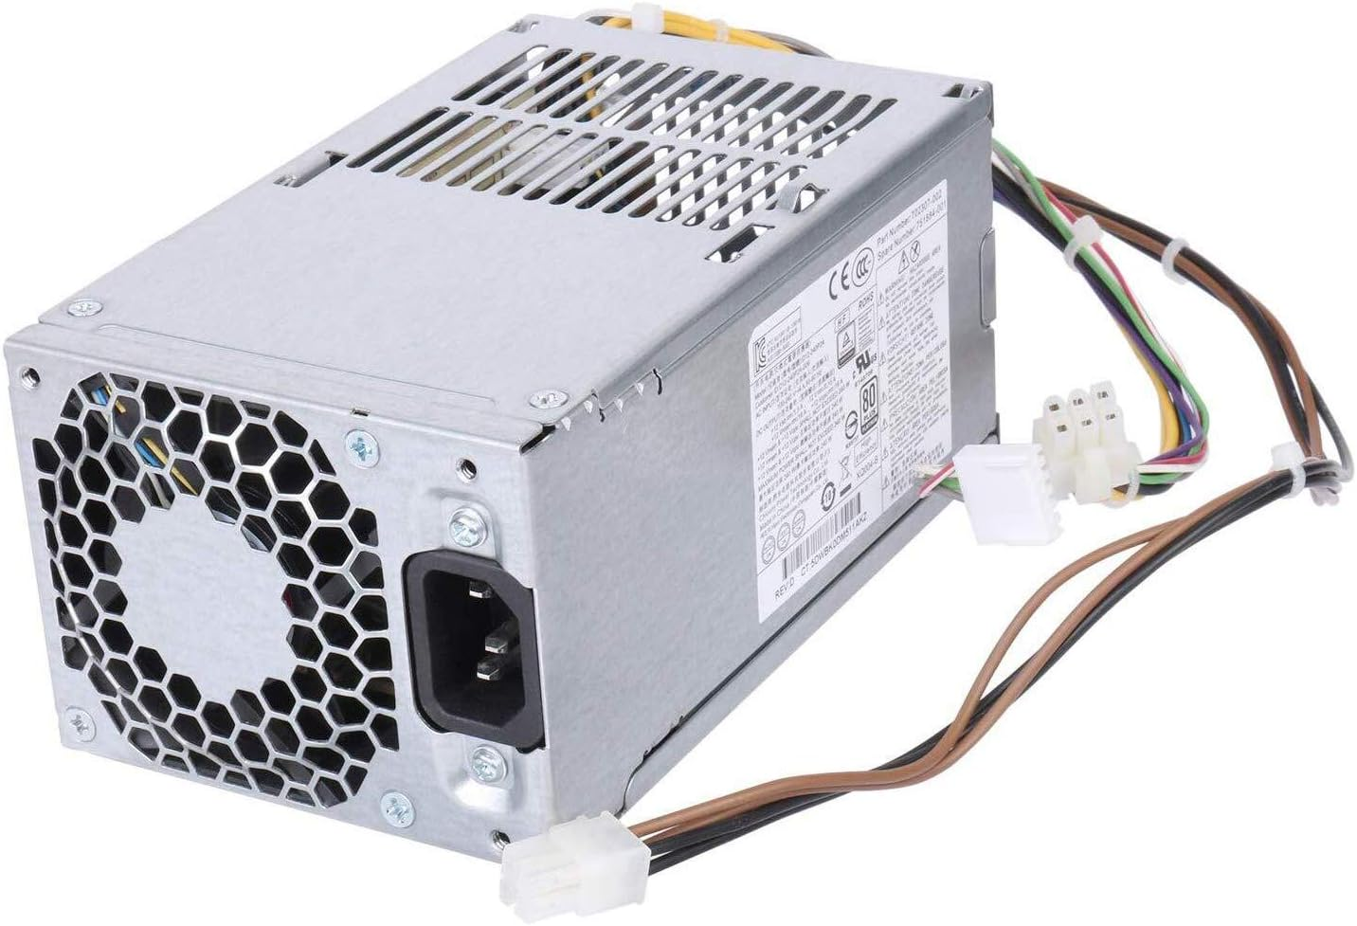
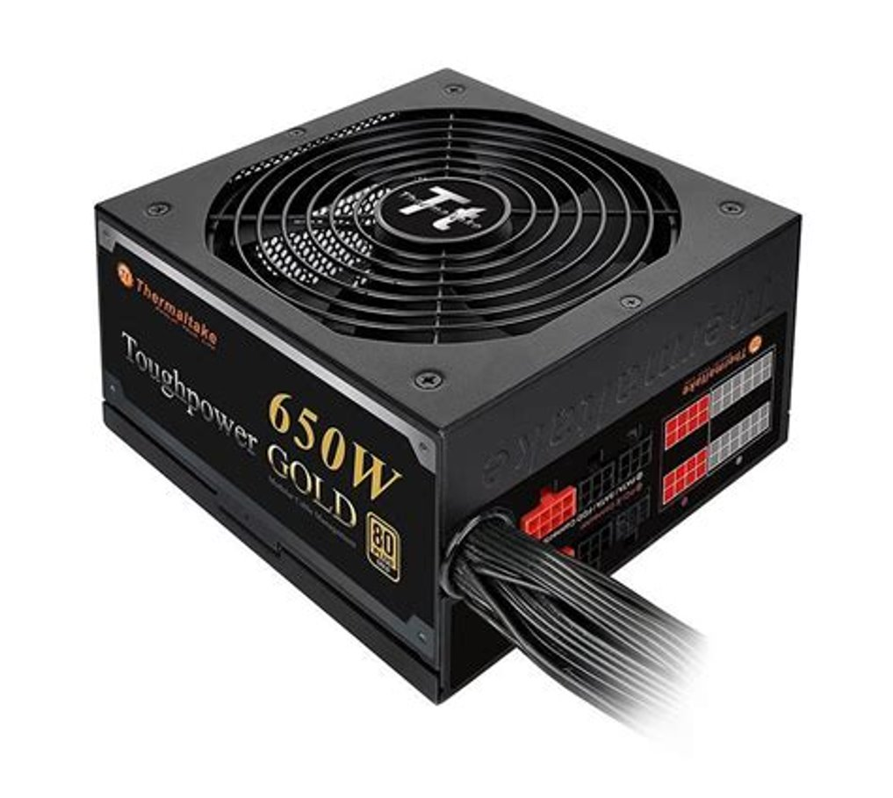
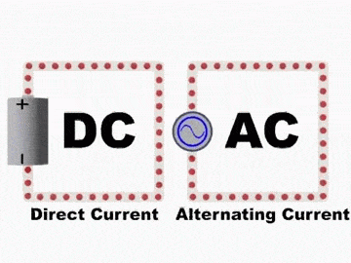
2) Power Supply
Main purpose: Converts AC power (alternating current) from wall socket to DC power (direct current). Direct current (0 or 5V) is used to power digital circuits.
Note: PSU have their own fans:
Energy conversion releases a lot of heat!

Slide 9
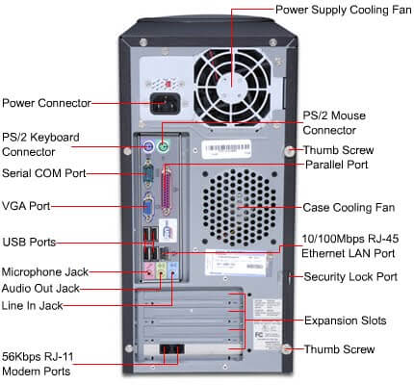
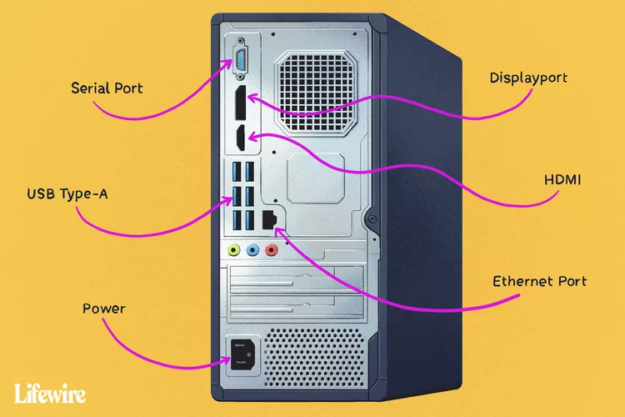
Activity: Feeling Your Way
With a partner, take it in turns to close your eyes and feel around the back of a PC.
Try and identify the connectors you find. Your partner can help you by confirming your guesses.

Slide 10
Uninterruptible Power Supply
In the case of a power outage, an Uninterruptible Power Supply (UPS) can keep a computer running for a few minutes to several hours depending on the sophistication of the UPS. See https://www.wikihow.com/Buy-and-Use-an-Uninterruptible-Power-Supply for an example
We will talk more about uninterruptible power supply when we start speaking about server hardware.

Slide 11
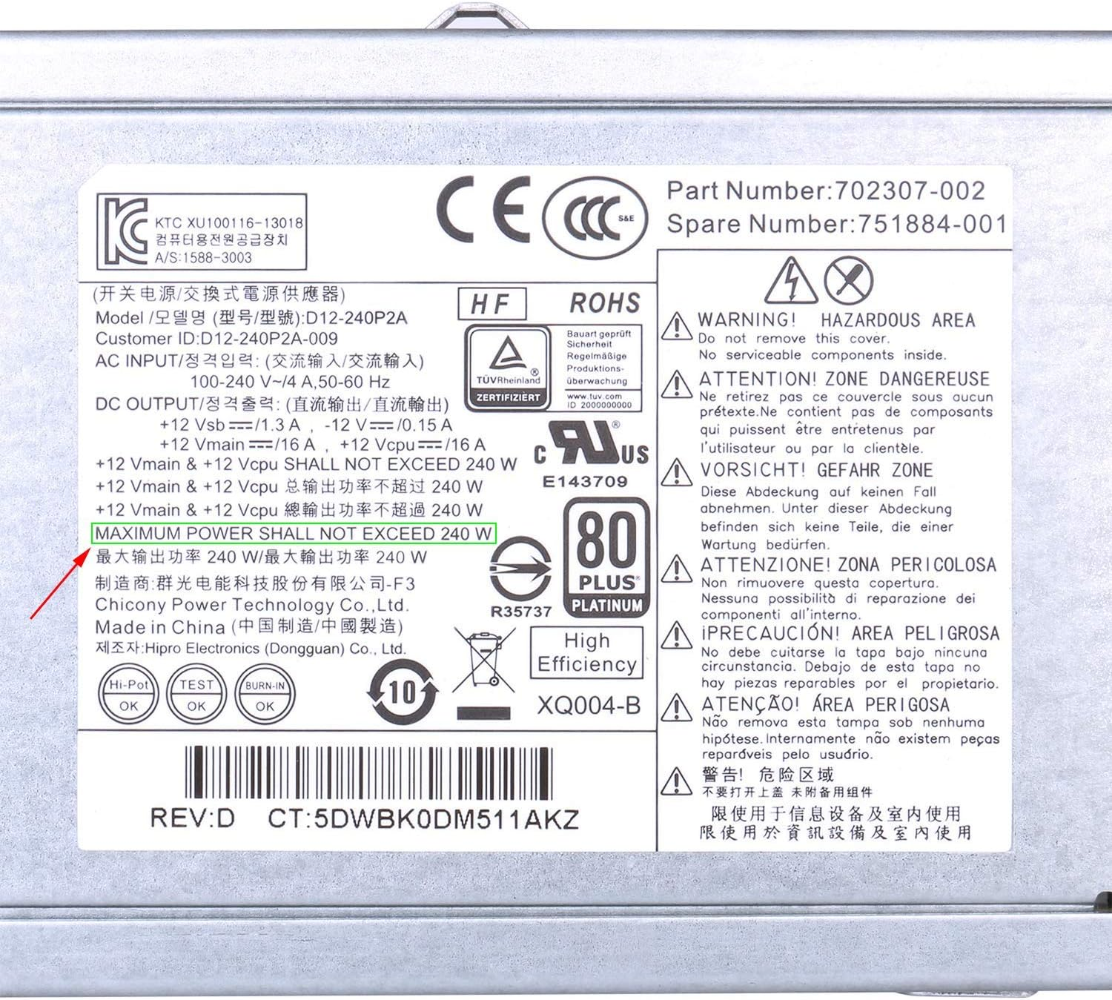
2) Power Supply
Computers can only tolerate slight fluctuations in power without needing to shut down
.
Important: Never open a power supply! The capacitors contained within can keep a dangerous high voltage, high power charge long after being unplugged.
Demo: PSU What are the supported DV outputs?

Slide 12
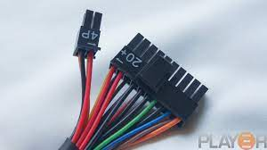
Power Supply Connectors
Most power supply connectors are : 20 + 4 pins
Usually made up of wires of various colors:
Yellow 12V
Red 5V
Orange 3.3V
Other colors may be ground 0V

Slide 13
Power Supply Ratings
Useful for Assignment 1
Ratings:
Wattage (amount of power delivered, must be greater than the sum of power required by all parts, some power supplies can provide more power than others)
Efficiency (Law of thermodynamics: 100% power input cannot be converted to 100% power output; some power supplies have higher efficiency ratings than others)
For more detailed explanation: https://www.newegg.com/insider/how-to-choose-a-pc-power-supply-buying-guide/

Slide 14
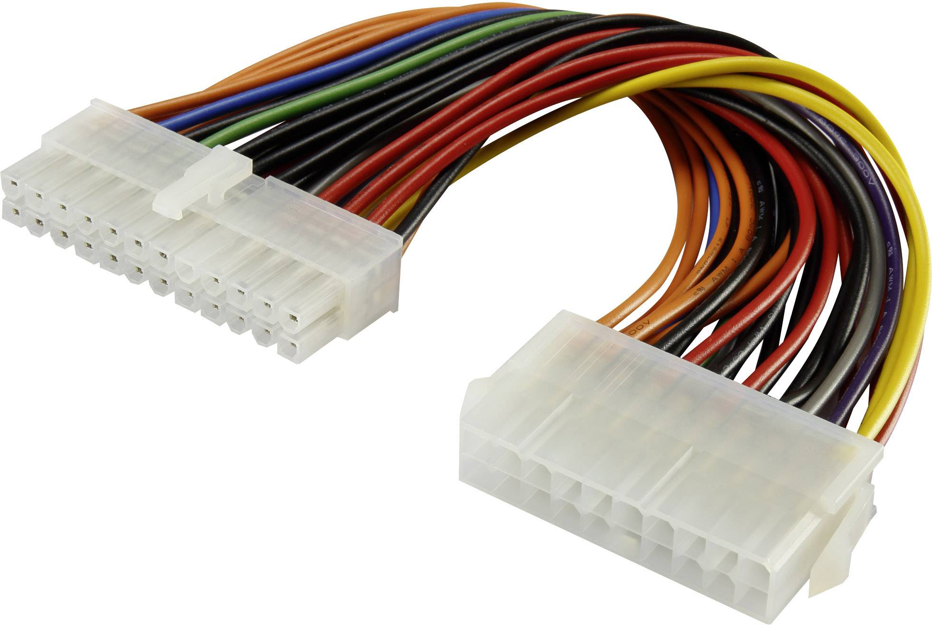
3) Connectors
These connect specific components to various ports on the motherboard.
Most connectors are keyed (can only be inserted one way).
Note: Always check the pins if you have trouble with a connector. “If it doesn’t go in like butter, it doesn’t go in at all” -- never force a connection! you are likely going to damage the pins.

Slide 15
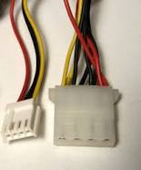
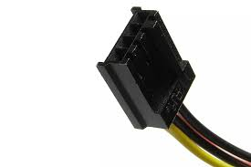
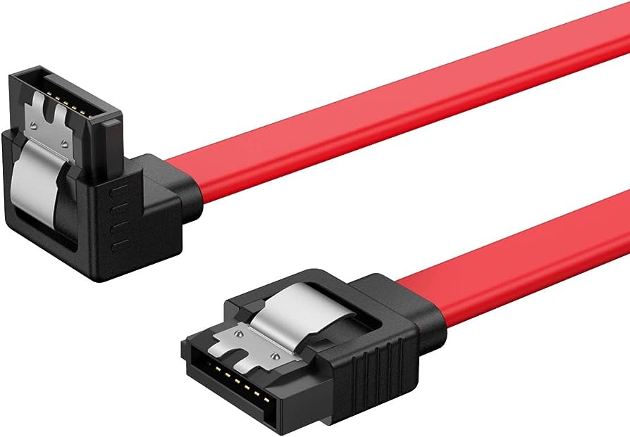
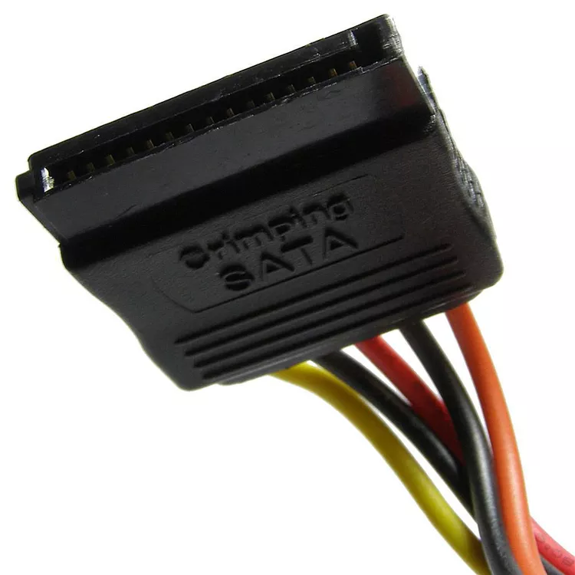
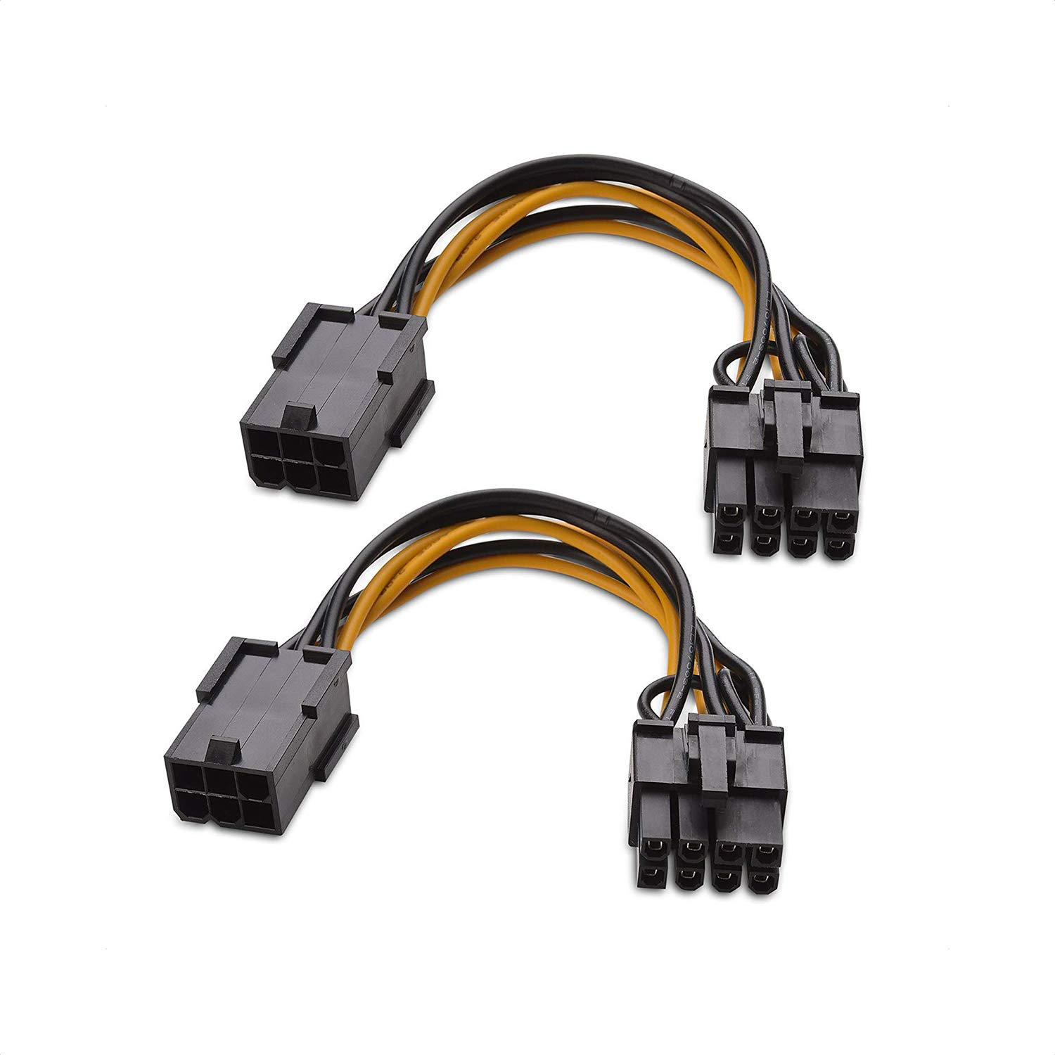
Types of connectors
Floppy drive connectors (old days)
SATA Cables (for hard drives)
Molex – Less used but still present
Power
Data
PCIe (Video Cards)

Slide 16
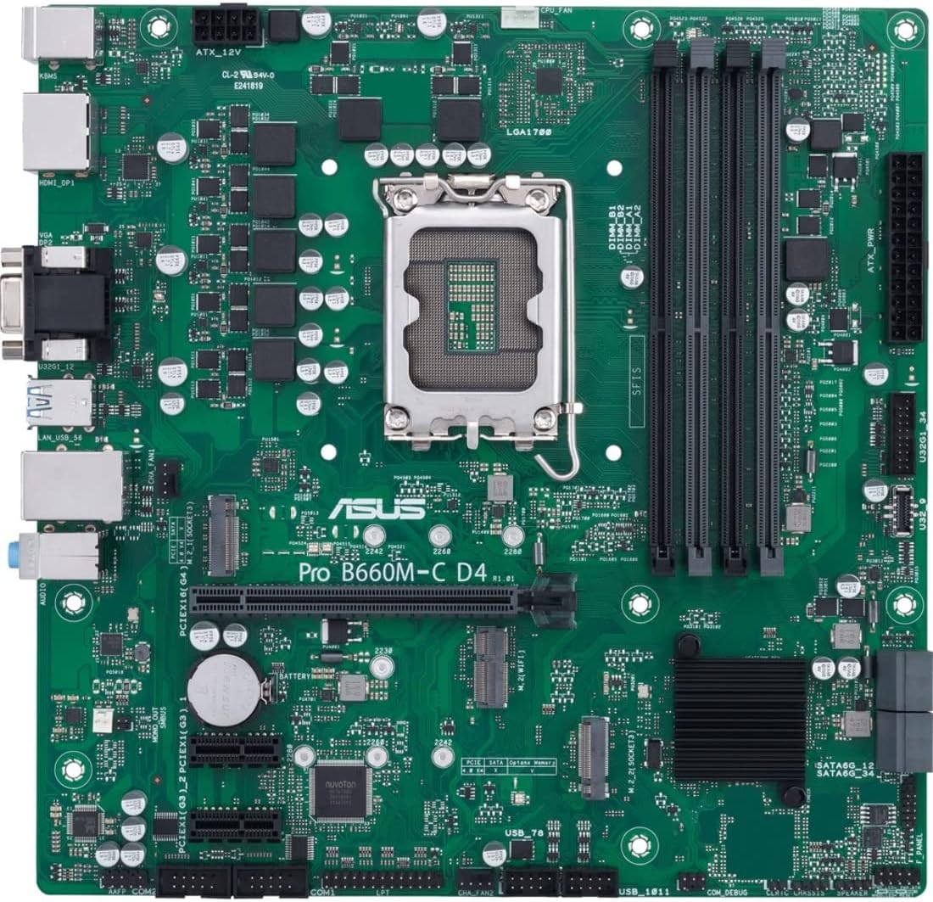
4) Motherboard (overview)
Connects the CPU, RAM, Expansion ports.
Composed of various chips all combined into north and south bridges
More on those in a few weeks...

Slide 17
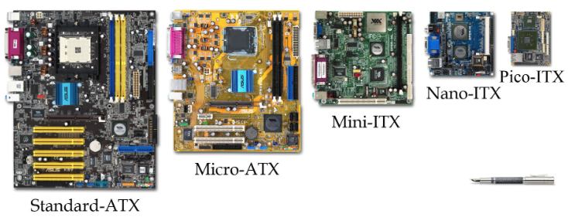
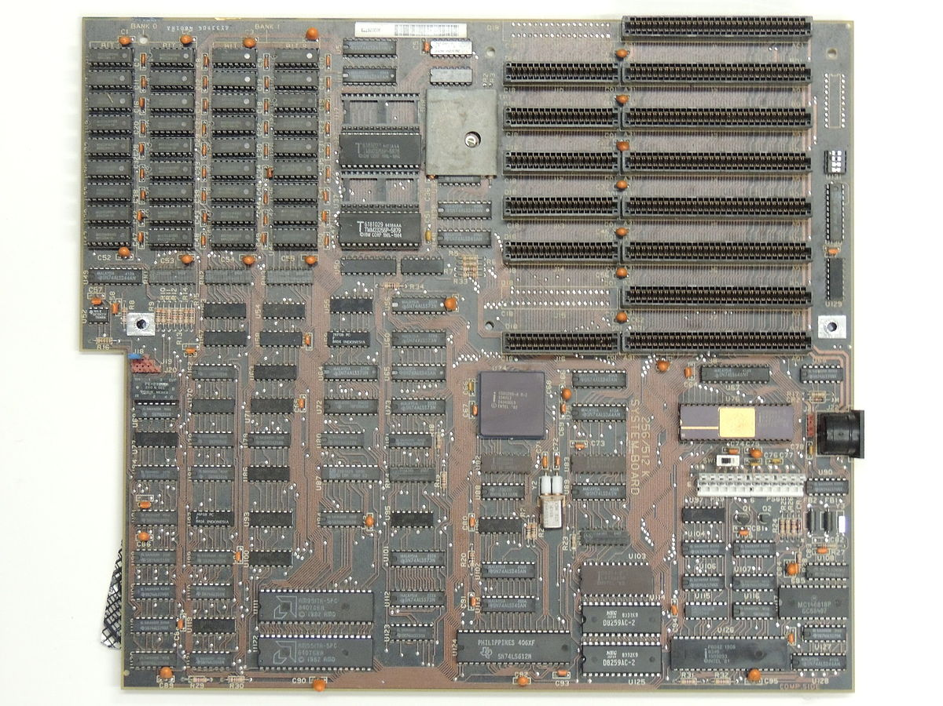
4) Motherboard - Form Factors
Main circuit board and controls the electrical pathways (buses) found in a computer.
The buses allow data to travel between the various components of a computer.
Various form factors, e.g. AT, ATX, LPX, BTX, ITX.
IBM 1980s
Huge 12 x 13", no ports
1995
12 x 9.6 "
2001
9.6" x 9.6"
2003
6.6x 6.6"
2005
4.7 x 4.7"
2008
3.9 x 2.8"
AT
Notes:
ITX – used for imbedded systems such as routers

Slide 18
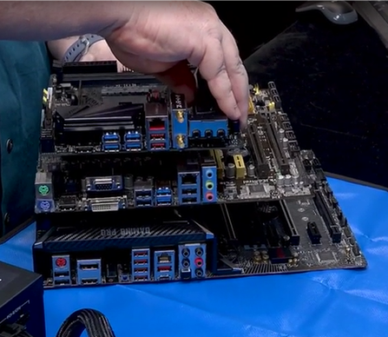
4) Motherboard - Form Factors
You'll notice that the I/O Ports on the mother board is always located around the same area.
This is to keep certain consistency across manufacturer and regardless of the form factors

Slide 19
4) Motherboard (Form Factors)
AT
Invented by IBM in early 1980s, now obsolete.
Huge in size (approximately 12 x 13 inches).
Needed lots of space for power supply and its various chips.
Lacked external ports, only allowed for monitor and keyboard.
ATX
Created in 1995 to meet the need for more connectors.
Got off to a slow start but by 1998 became the most common form factor.
Biggest change to AT was the rear panel with standard set of ports for expansion.
Power supply position for better airflow, CPU and RAM positioned for easier access.
Variations 12x9in (full size), 9.6x9.6in (microATX), 9x7.5in (FlexATX no longer used).
Notes:
Extra slide for studying

Slide 20
4) Motherboard (Form Factors)
ITX
Created in 2001 to meet the demand for smaller computers.
ITX failed but led to development of smaller form factor (SSF) motherboards.
MiniITX (6.7x6.7in), NanoITX (4.7x4.7in) and PicoITX (3.8x2.8in)
Commonly used for embedded systems and specialized devices such as routers.
Require very little power, therefore produce less heat.
Proprietary
Some computer manufacturers make motherboards that work only with their cases.
Services and upgrades usually need to be handled by authorized dealers.
Often hard to get replacement parts and they are usually expensive.
Notes:
Extra slide for studying

Slide 21
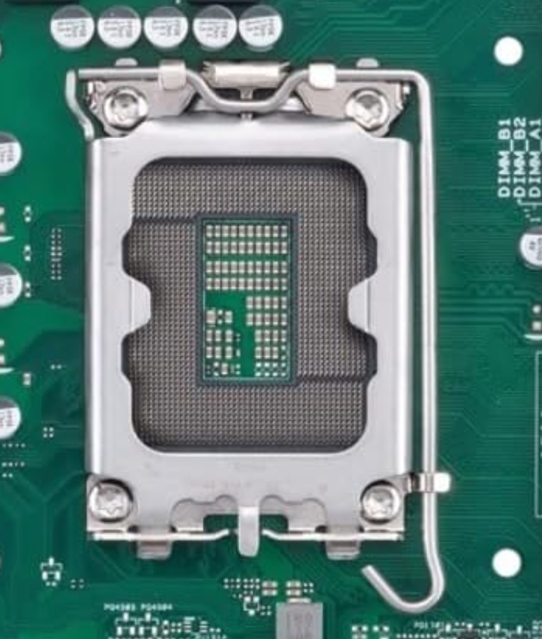
4.1) Motherboard – CPU Socket
Let’s have a closer look at the CPU Socket: This is where the CPU will sit

Slide 22
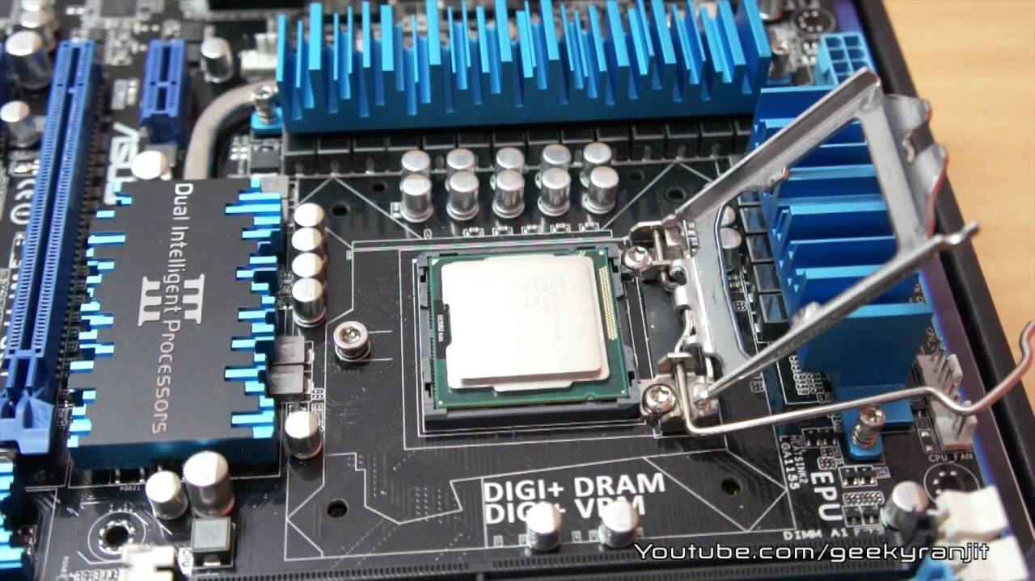
5) CPU
Most important element of the computer in terms of computing power.
Brains of the computer.
Responsible for interpreting and executing the commands from the software.
While the CPU is processing one step of the program, the remaining instructions and the data are stored in a special memory called cache.
More on this on week 5

Slide 23
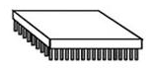
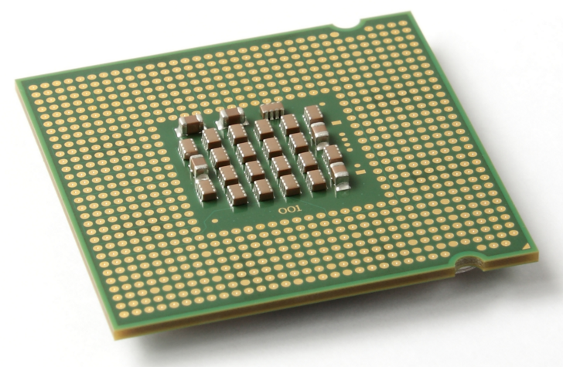
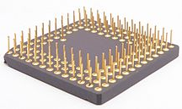
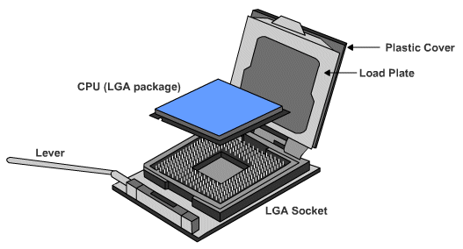
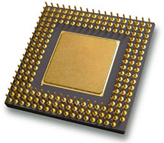
How to Connect a CPU?
CPU connection on the motherboard is known as the CPU socket.
The CPU is connected to the motherboard in one of two ways:
Pin Grid Array – PGA
Pins are on the CPU (underside of the processor).
Socket on motherboard includes holes that line up with the CPU pins.
Land Grid Array – LGA
Pins are on the motherboard (on socket) instead of on the processor.

Slide 24
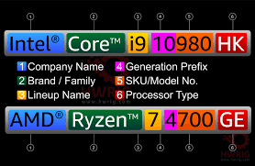
CPU Brands
Intel
AMD
Higher price CPUs
Excellent for a variety of tasks
Good balance in performance and heavy processing tasks
Good budget CPUs for gaming
Very good for PCs focused on gaming
Less power consumption
Less heat.
Very Important for lab2

Slide 25
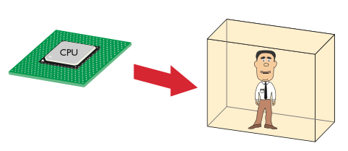
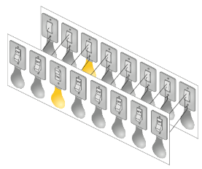
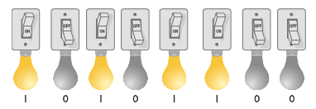
CPU Core Components
“Man-in-a-box”
Clever guy who can perform any mathematical function quickly.
He lives in a closed-up box so it is hard to communicate with him.

Slide 26
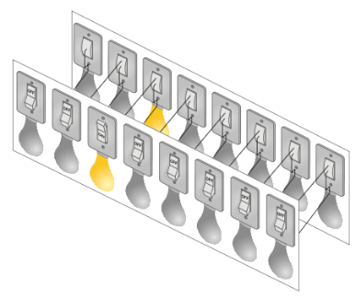
CPU Analogy: “Man in a Box”
Imagine we install a set of 16 lightbulbs
(8 inside, 8 outside).
These can be controlled by us and by the man-in-the-box. This is our external data bus (EDB).
We can communicate with each other as long as we agree ahead of time what each pattern of light bulbs means.

Slide 27
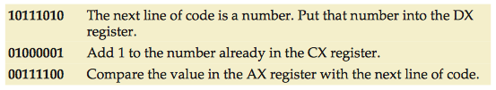
Codebook
Codebook
This defines the commands that we can give to the man in the box.
If we both have a copy, then we can give him commands and he can understand them.

Slide 28
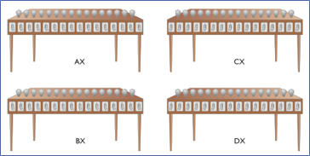
Registers
Registers
We can give the man some work and see what he replies.
But to do his work, the man needs at least four workstations.
General purpose registers are the most common. AX, BX, CX, DX (Intel).

Slide 29
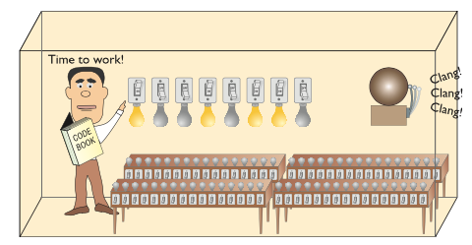
Clock
Now we are ready to put our man to work. We can send him the first command by lighting up the wires on the EDB.
But how does he know when we have finished setting up the light bulbs?

Slide 30
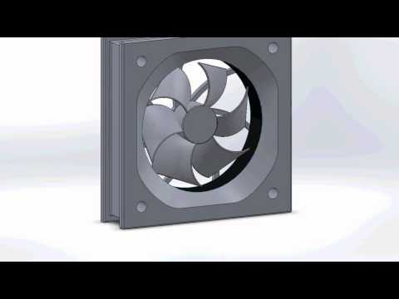
6.1) Cooling Devices - Fans
The flow of current between the electronic components generates heat. The man in the box is heating!!
Fans inside the case increase airflow and removes heat.
Occasionally video cards or other components have their own fans to cool them.

Slide 31
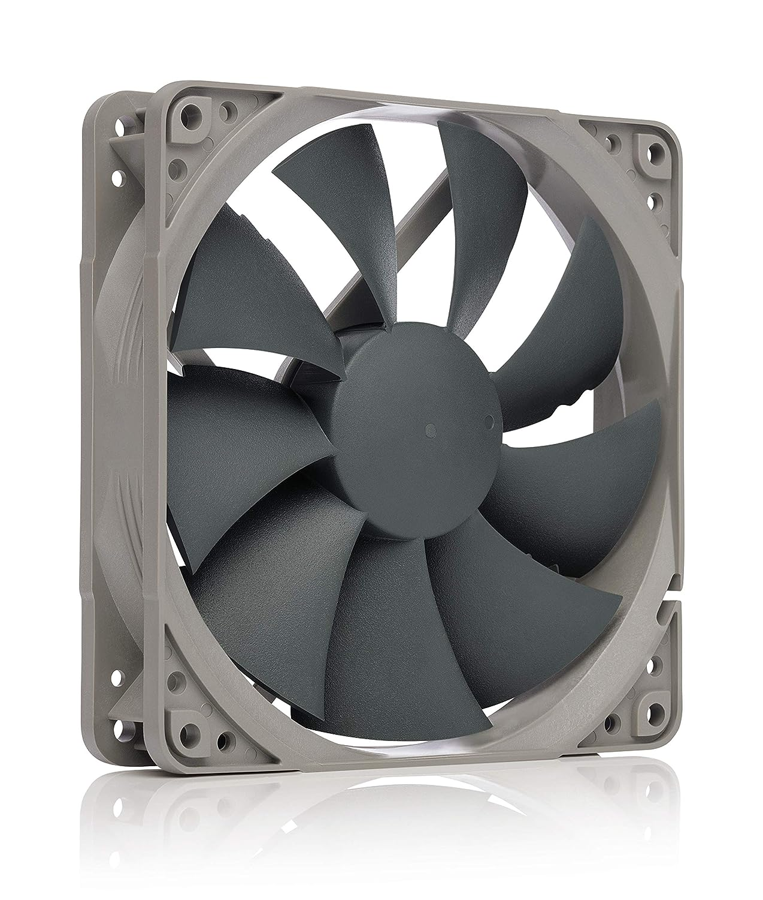
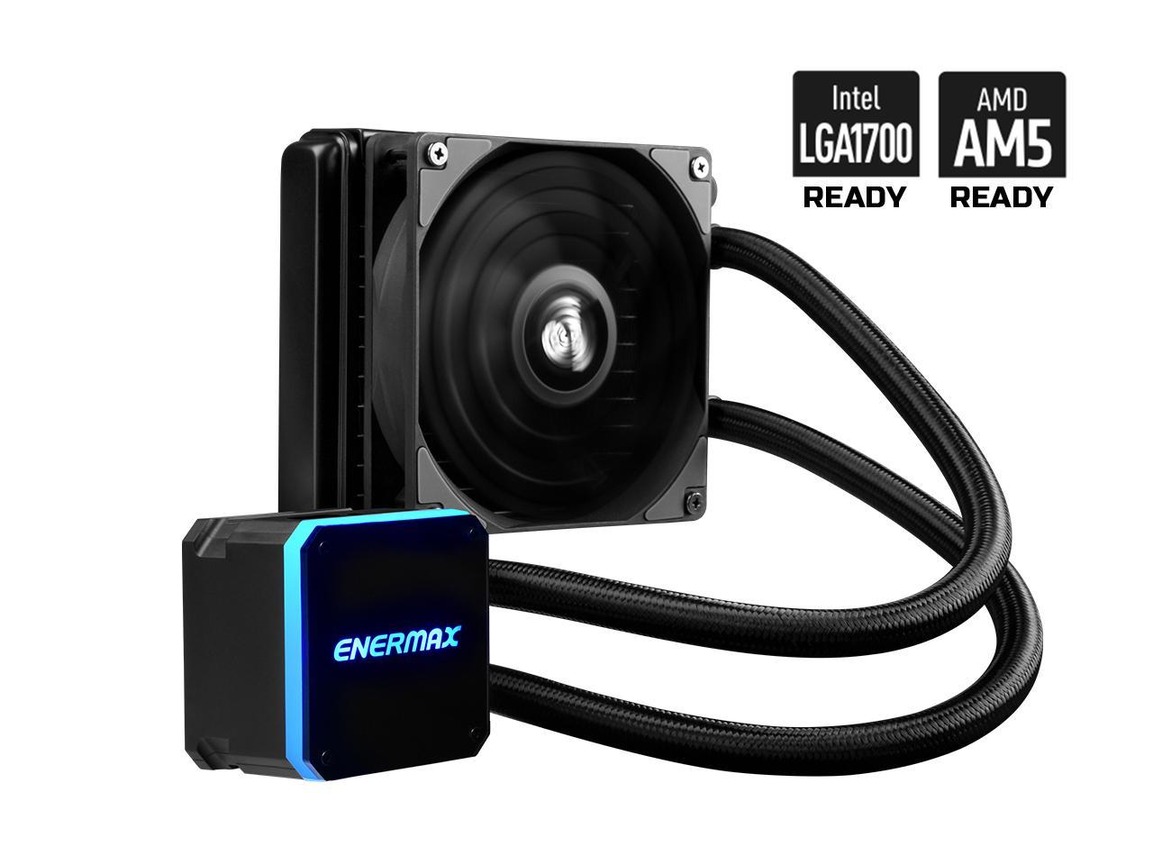
Activity: Cooling devices Fans vs Liquid cooling
With a partner take 5-7 minutes to research the major differences between Fans and liquid cooling devices.
Add the pros and cons in this jamboard
VS

Slide 32
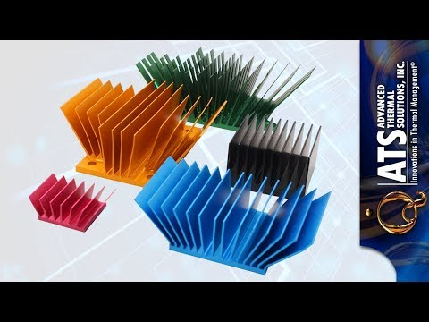
6.2) Cooling Devices – Heat sinks
Heat sinks also draw heat away from the CPU core.
A heat sink is a piece of copper or aluminum that resides between the processor and the CPU fan.
It absorbs the heat from the processor and the fan disperses the heat.
Increase of the surface area

Slide 33
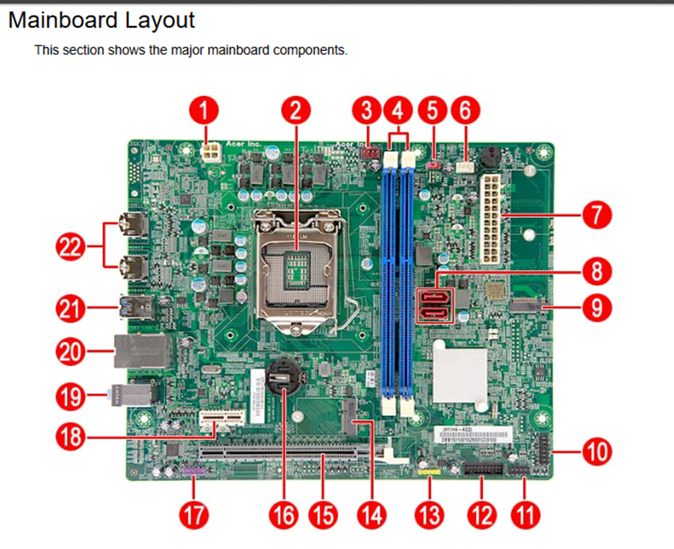
Internal Components: General Overview
Let's have a closer look at the RAM slots and RAM

Slide 34
4.2) Motherboard – RAM slots
Let’s have a closer look at the RAM slots

Slide 35
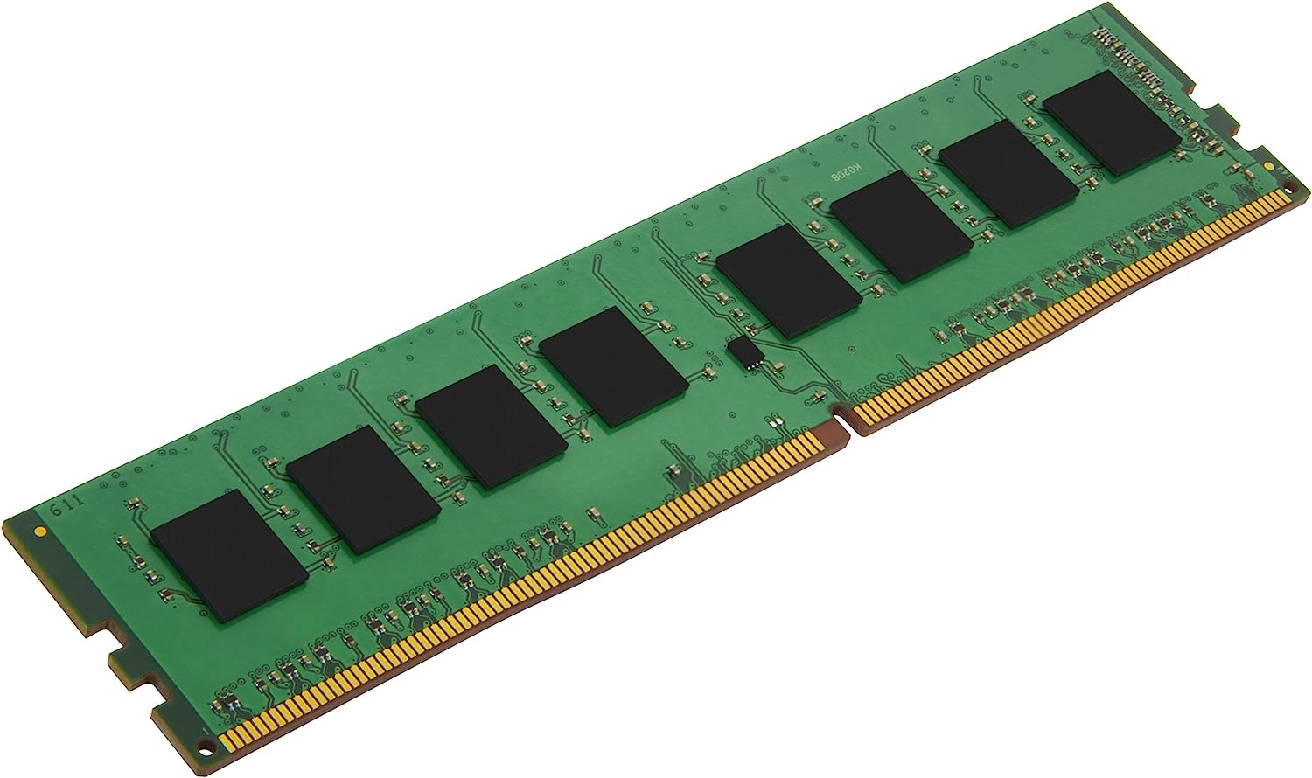
5) Main Memory
Referred to as RAM (Random Access Memory)
RAM is a collection of integrated circuits (chips).
Considered the “Primary” storage for the CPU.
Temporary storage for data and programs that are being accessed by the CPU.
Volatile memory: contents are erased when the computer is switched off. (or when power is lost)

Slide 36
5) Main Memory (cont.)
More RAM means more capacity to hold and process large programs and files.
Maximum installed is limited by the motherboard and the operating system.

Slide 37
4.1) Motherboard – Expansion Slots
Let’s have a closer look at what we call expansion slots.
Expansion slots are ports inside a computer found on the motherboard. They provide the possibility to expand the hardware of your PC.
For example, you may want to install a network card, a sound card, and most importantly a video card.

Slide 38
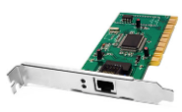
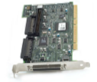
5) Expansion Slots
Expansion slots allow us to increase the functionality of a computer by adding controllers for specific devices (often called adapter cards) e.g. sound, video, NIC (network Interface Card).
PCI used in most computers, 32 or 64 bit
AGP designed to be used by video adapters
PCIe replacing AGP in newer computers
ISA older, rarely used, 8 or 16 bit
EISA older, rarely used, 32 bit
MCA IBM proprietary 32 bit, older, rarely used
PCI-X 32 bit, can run up to four times faster than PCI
MiniPCI 32 bit, used by laptops, has three different form factors

Slide 39
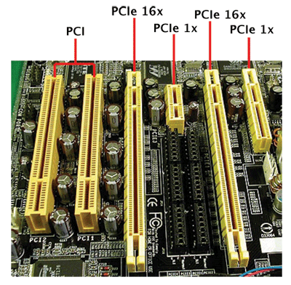
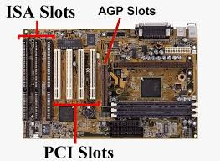
6) Expansion Slots

Slide 40
6) Expansion Slots
AGP - Video card.
AMR - Modem, sound card.
CNR - Modem, network card, sound card.
EISA - SCSI, network card, video card.
ISA - Network card, sound card, video card.
PCI - Network card, SCSI, sound card, video card.
PCI Express - Video card, modem, sound card, network card.
VESA - Video card.

Slide 41
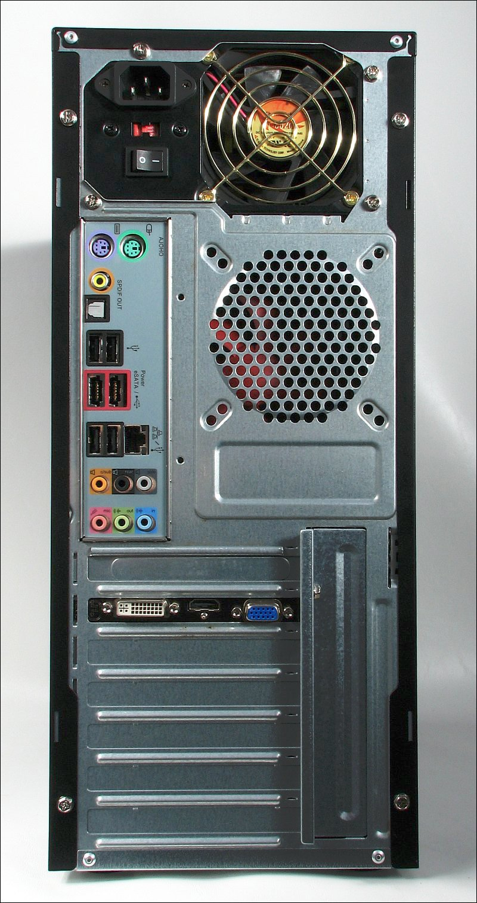
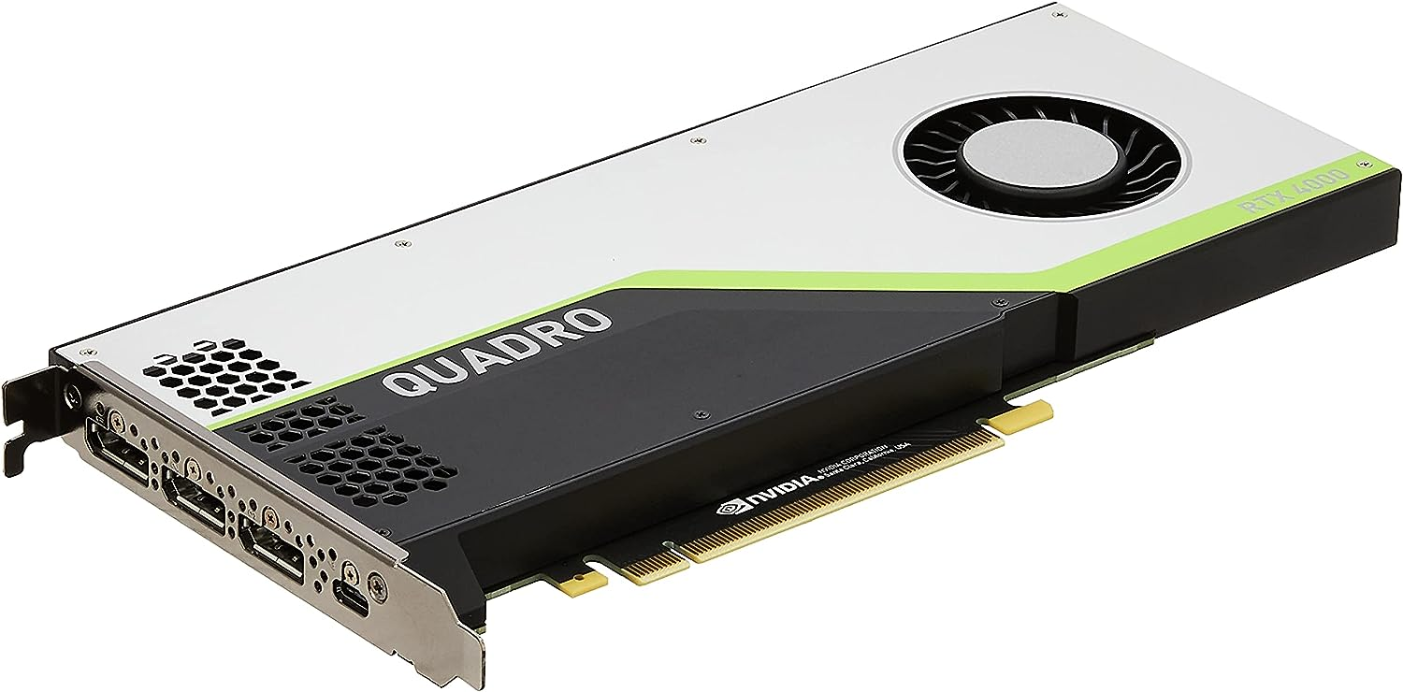
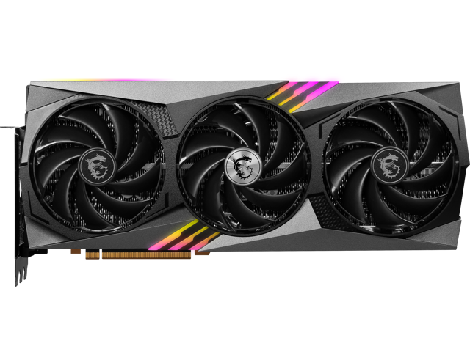
7) Graphics Cards
Also known as Video cards or Graphical Processing Units
One of the most interesting use of expansion slots is the addition of video cards, also known as Graphical Processing Unit.
Its speeds up the processing power of a computer.
Often useful in video gaming, video rendering, scientific parallel computing

Slide 42
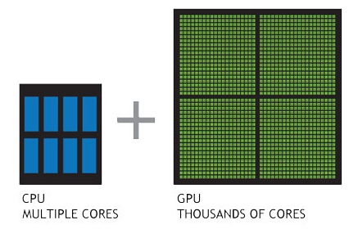
GPU VS CPU

Slide 43
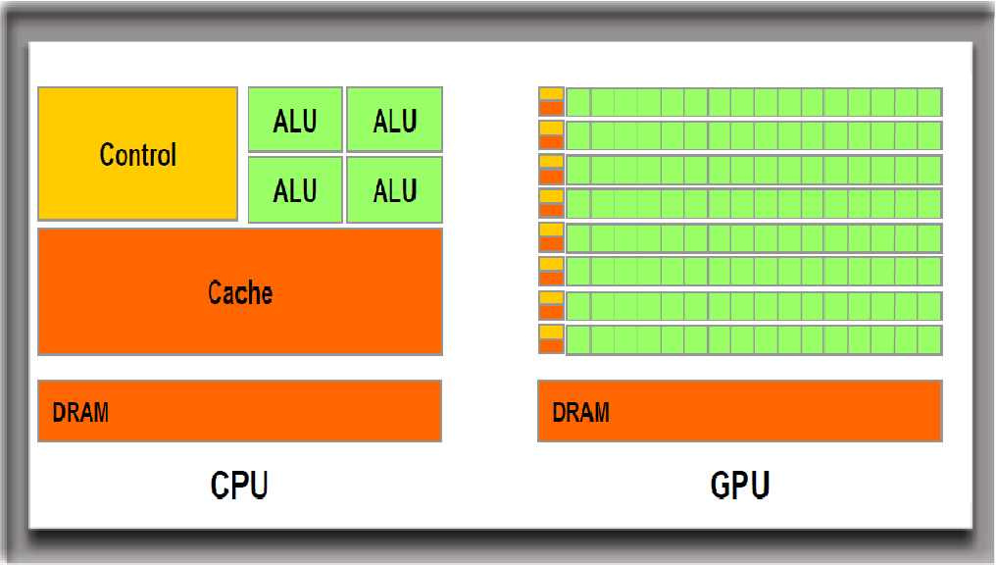
CPU vs GPU
GPU cannot replace the CPU because their architecture is different and meant for different purposes
GPU is great to parallelize computations!
But the GPU is not as versatile as the CPU which has a larger instruction set (code book)

Slide 44
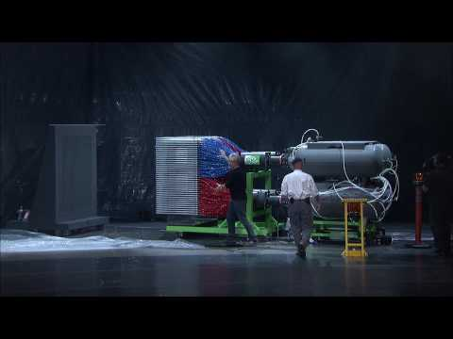
GPU vs CPU
(click to load the video)

Slide 45


8) Storage Devices
Storage devices store data permanently.
Some are installed inside the case (e.g. hard drive);
Some are removable and portable (e.g. external flash drive).

Slide 46








7) Storage Devices (cont.)

Slide 47
7.1) Storage Devices: Floppy Drive
Uses 3.5 inch floppy disks (or 5.25 inch floppy disks - older).
Largely obsolete.
Magnetic disks store up to 1.44Meg of data.

Slide 48
7.2) Storage Devices: Hard Drive
Hard Disk Drive (HDD)
Traditional hard drives.
Uses magnetic-based storage on a moving disk (somewhat like a vinyl player)
Magnetic hard drives have drive motors that spin the magnetic platters and move the drive heads.
Speed measured in revolutions per minute
Demo: how does it look inside an HDD

Slide 49

7.3) Storage Devices: Hard Drive
Solid State Drives (SSD)
Do not have moving parts and use semi-conductors to store data.
Non-volatile flash memory chips manage the storage on an SSD, resulting in faster access to data, higher reliability and reduced power usage.
Usually configured as C: drive on a Windows machine and contains the operating system and applications. Storage capacity can range from gigabytes to terabytes.

Slide 50

7.4) Storage Devices: Tape Drive
Magnetic tapes are often used for backups or archiving data. Still used/created to this day! Very cheap per GB costs.
Data retrieval can be fast but locating specific data is slow.
Can hold many terabytes.

Slide 51

7.5) Storage Devices: Optical Drive
Uses lasers to read the data on the optical media.
CD (compact disc) 700 Mb
DVD (digital versatile disc) 4-8 Gb.
BD (Blu-ray disc) 25-50 Gb.
Optical media can be:
Pre-recorded (read only)
Recordable (write once)
Re-recordable (read and write multiple times).

Slide 52
7.6) Storage Devices: External Flash Drive
Removable storage device that connects to a USB port.
These use the same type of non-volatile memory chips as SSDs and do not require power to maintain the data.

Slide 53
Storage Devices: Interfaces
To install a drive internally in a computer, the connection interface on the drive must be the same as the controller on the motherboard.
Motherboards support different types of interfaces.

Slide 54
Storage Devices: Interfaces Types (In order of oldest to newest)
IDE | Integrated Drive Electronics / Advanced Technology Attachment. Also called ATA. Early drive controller interface, originally only supported hard drives up to 540 MB. Uses a 40 pin connector, and maximum cable length of 46cm (18in).
EIDE | Enhanced Integrated Drive Electronics (also called ATA-2). Updated version of IDE, supporting larger drives and direct memory access. Uses a 40 pin connector.
PATA | Parallel version of ATA. Used internally due to maximum cable length of 46cm (18in). Largely replaced by SATA in newer systems.
SATA (most commonly used today) | Serial version of ATA, with slimmer and longer cables providing better airflow. Uses 7-pin connector (less pins means less issues with electromagnetic interference). SATA hard drives tend to be quieter than IDE drives.

Slide 55
Storage Devices: Interfaces Types (cont.)
eSATA | External serial ATA, provides a hot-swappable external interface for SATA.
SCSI | Small Computer System Interface. Drive controller that can connect up to 15 drives. Internal and external use, uses 25, 50 or 68 pin connector.
Note: Hot-swapping is the ability to connect and disconnect a device while the computer is on.

Slide 56

Computer Memory Hierarchy
Source: https://en.wikipedia.org/wiki/Memory_hierarchy

Slide 57


Build PC: How do I choose a motherboard?
Identify the user need for this PC: let's say Gamer PC
2. Go to PC Parts Picker
3. Select a CPU (that matches your needs) and ask yourself those questions
4. What would be the most appropriate form factor?
5. What's the max RAM needed?
6. Would you need expansion ports in the future?
7. What's the aesthetic feel of the PC? LEDs? Metal built?
This will restrict the types of motherboards you can use.

Slide 58
Q & A
Notes:
In Slide Show mode, click the arrow to enter the PowerPoint Getting Started Center.

